Slide 1
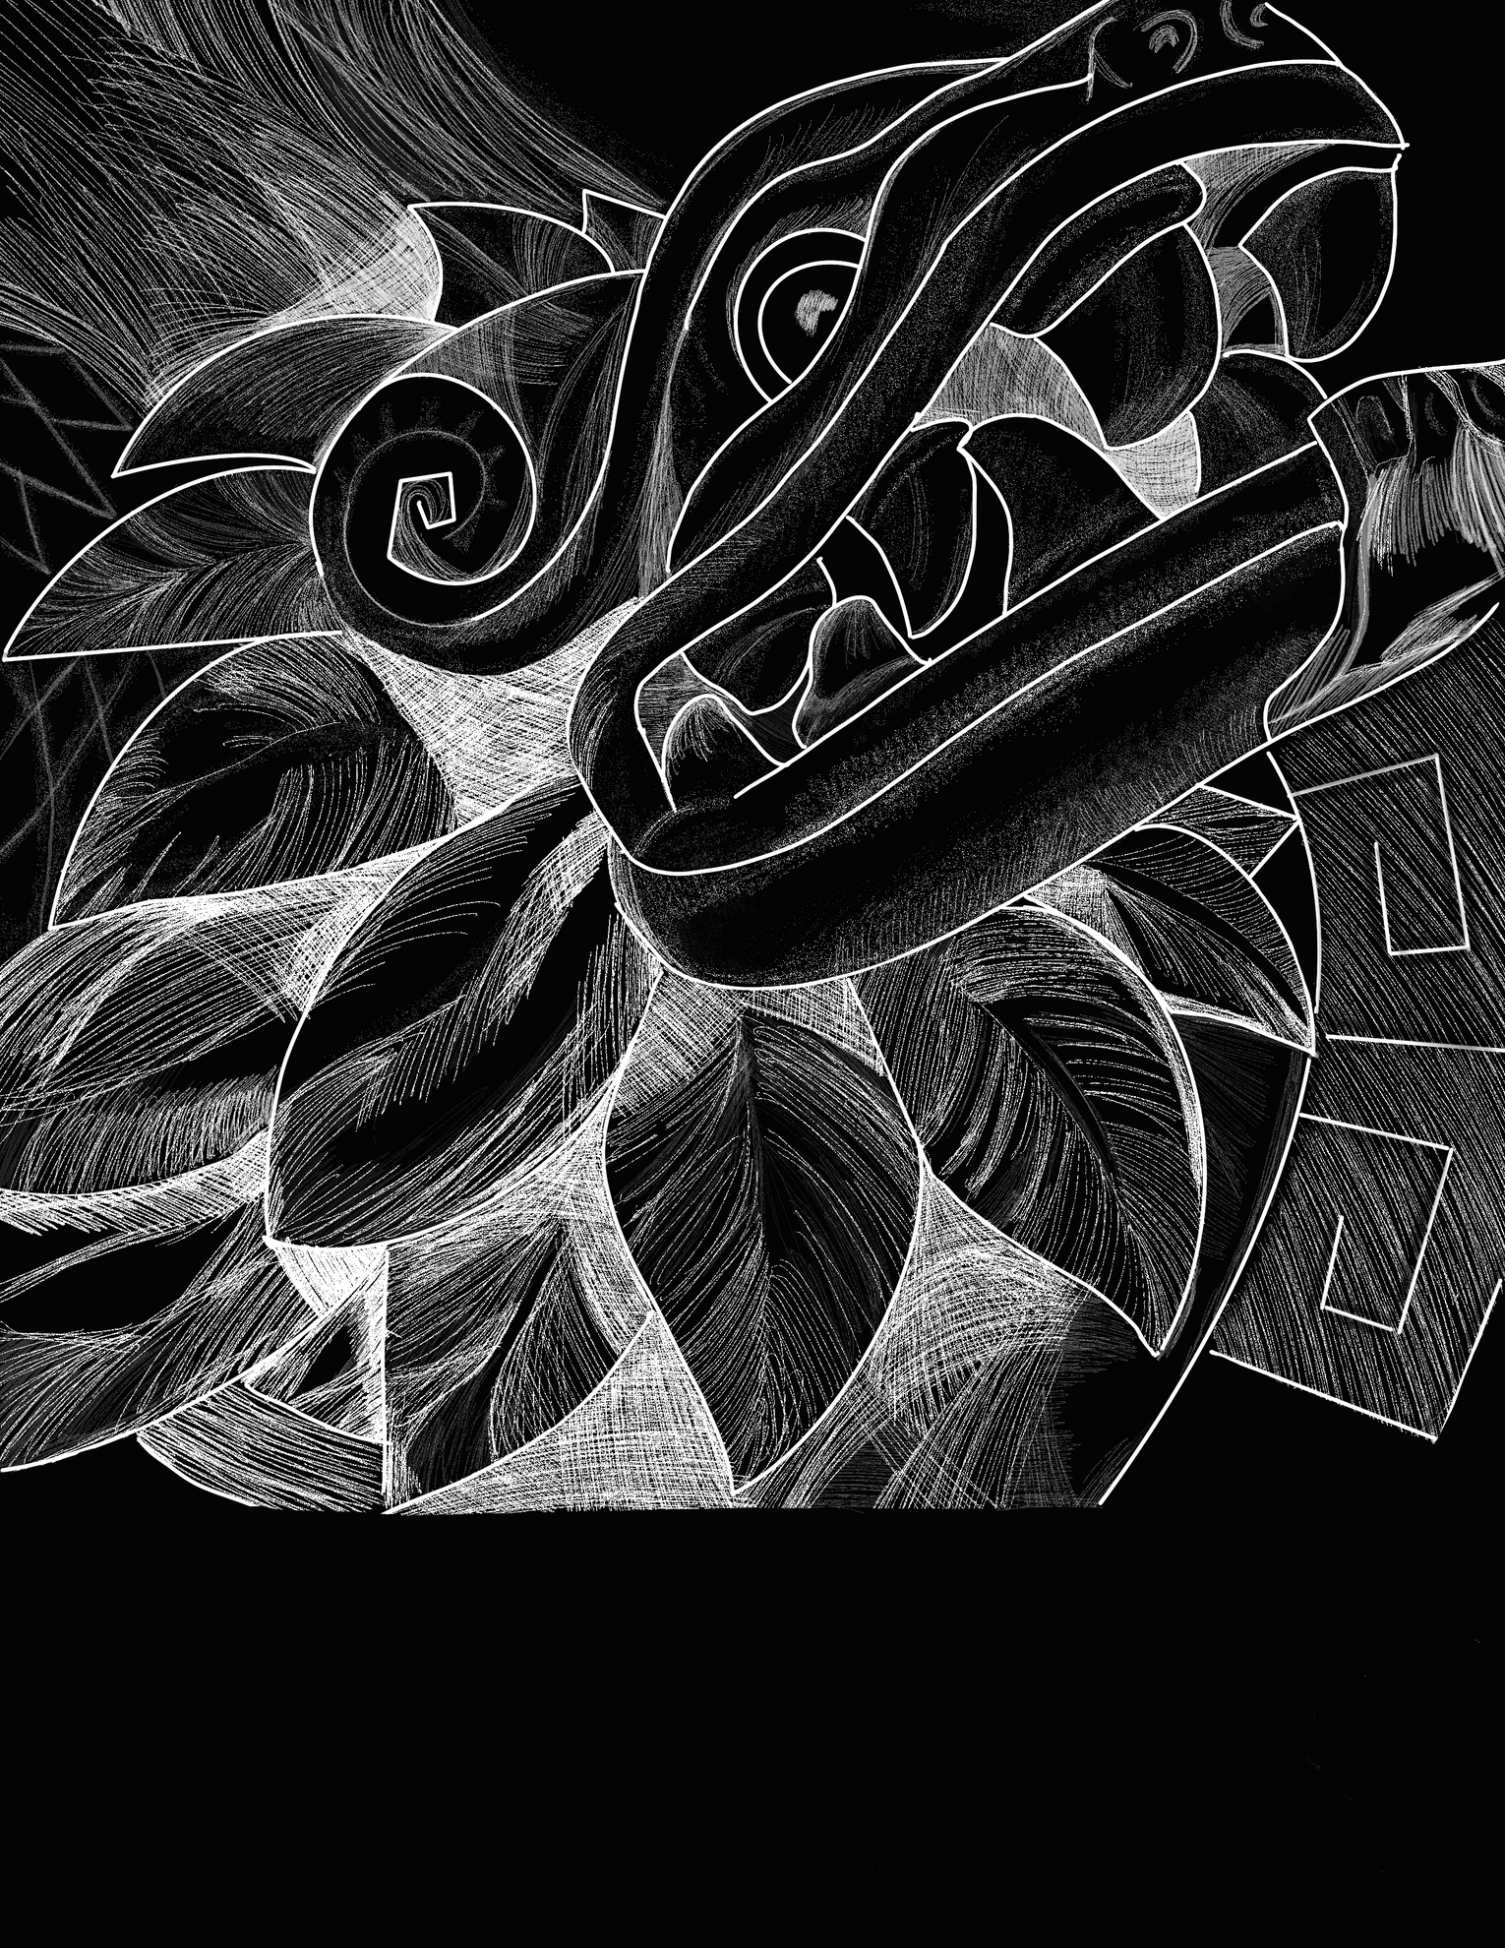

Scratchboard Workshop:
Aztec Deities
ARTE
WORKSHOP

Slide 2
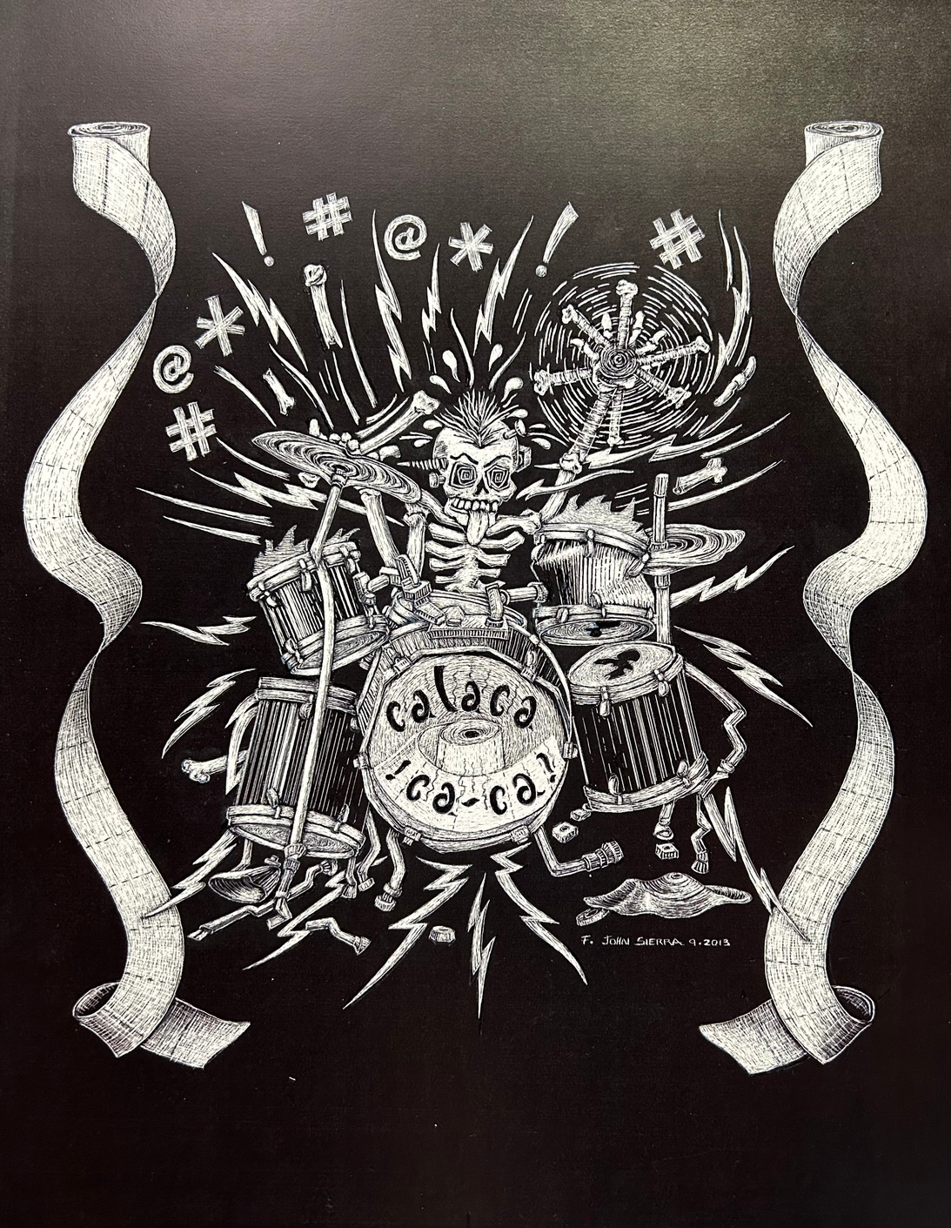
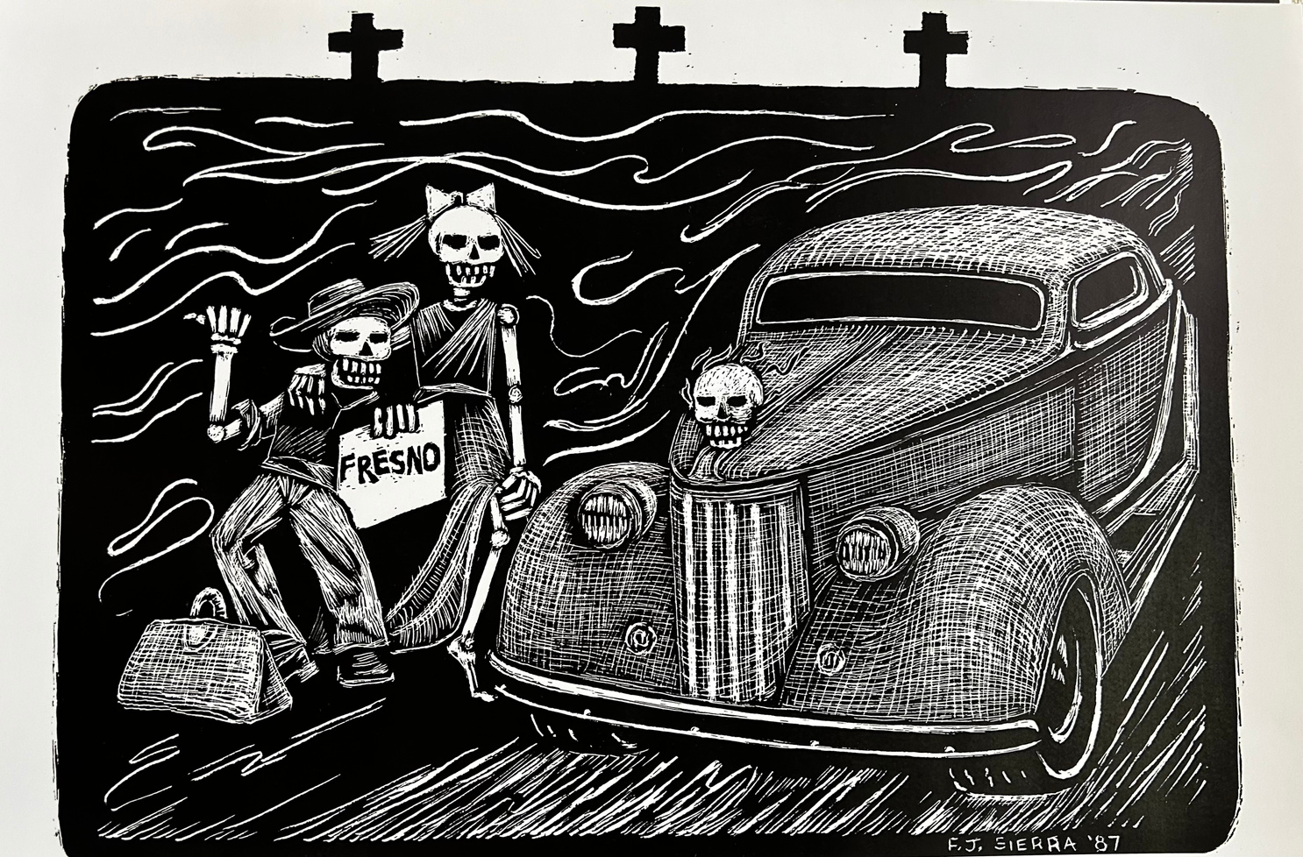
F John Sierra: Scratchboards
Hitchhiking to Fresno, 1987
Calacaa-ca-ca, 2013

Slide 3
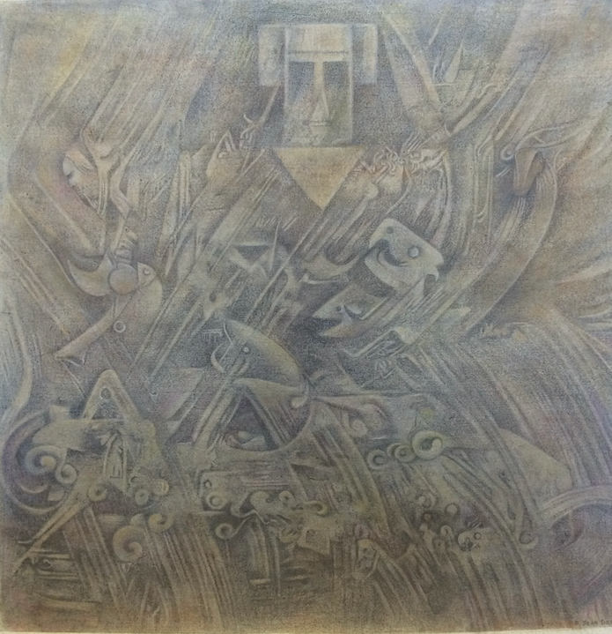
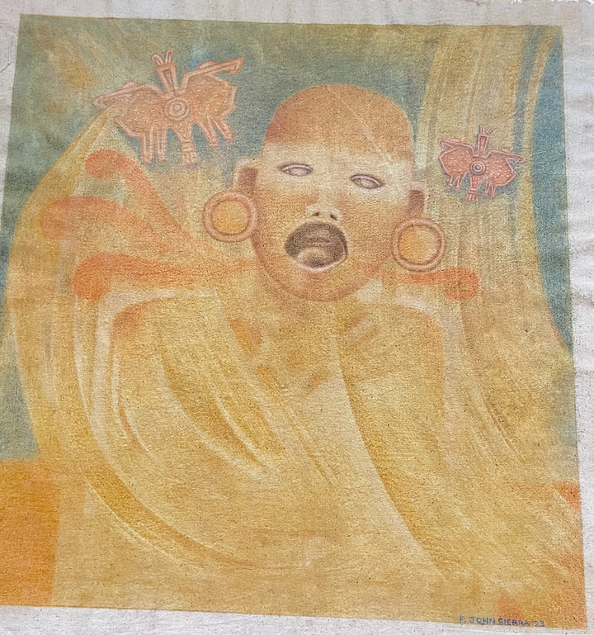
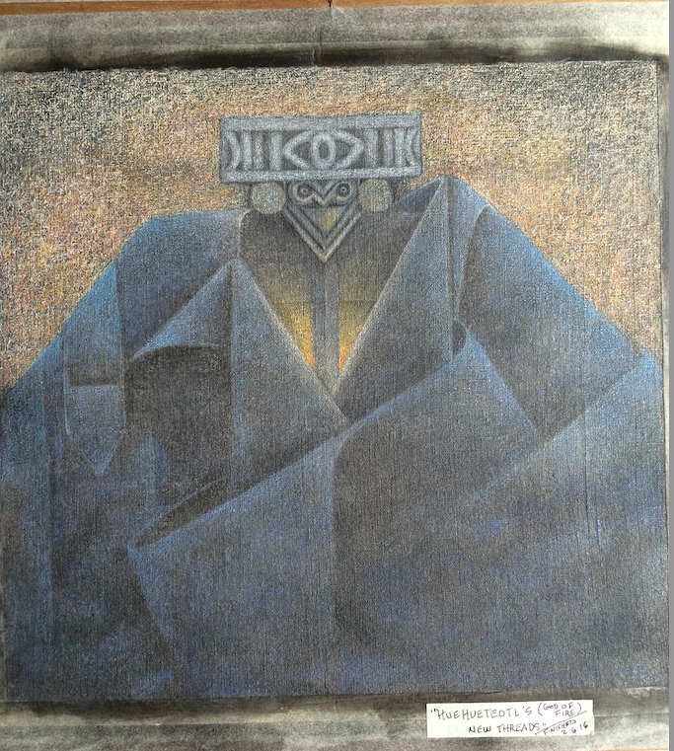
F John Sierra: Muslin Works
Quetzalcóatl Returns, 2016
Creator god, associated with wind, rain
Huehueteotl, 2016
God of Fire
Xipe Totec, 2023
God of spring, fertility, and agriculture

Slide 4
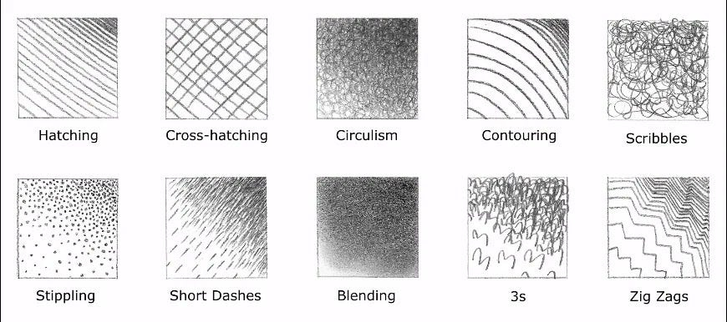
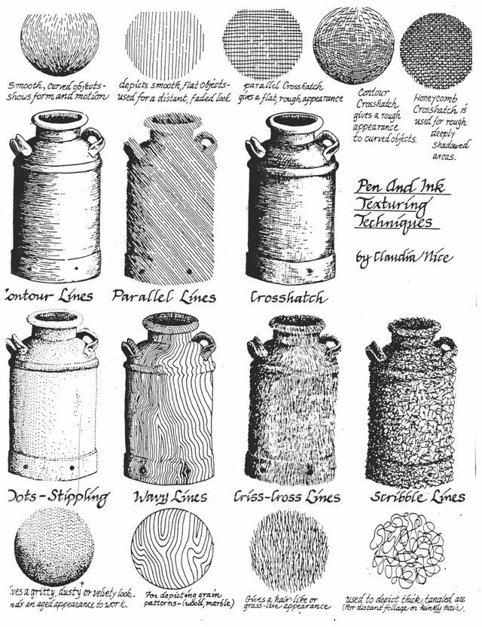
Mark-making Techniques
How are they used?

Slide 5
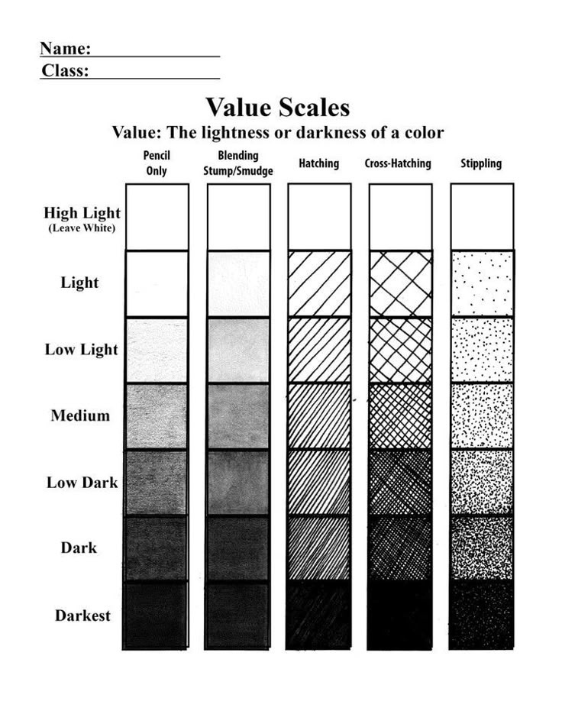
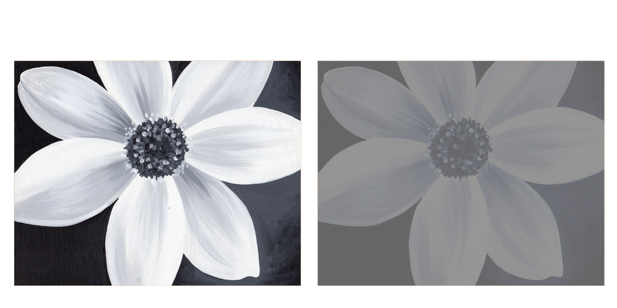
Value
&
Contrast
High Contrast
Low Contrast

Slide 6
Mark-making Techniques
Value
How are they used?

